Slide 1
UFC
File created on: 2/27/2020 9:46:14 PM

Slide 2


Slide 3
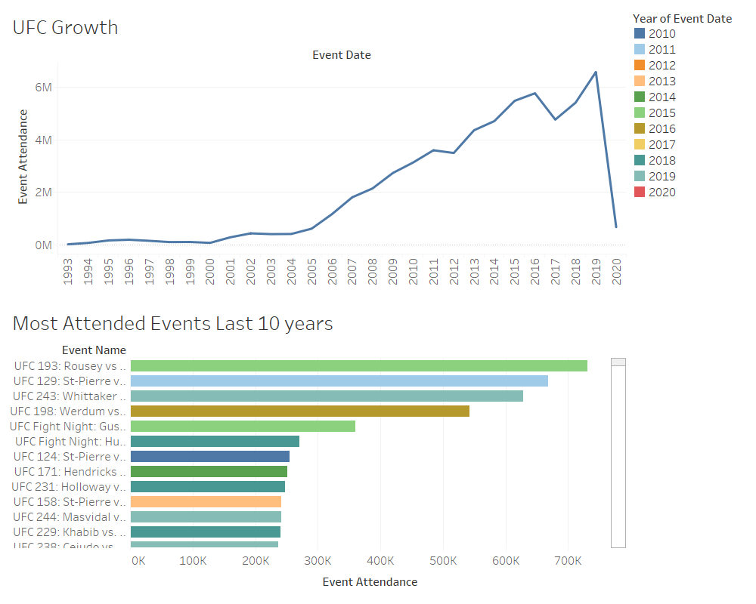

Slide 4
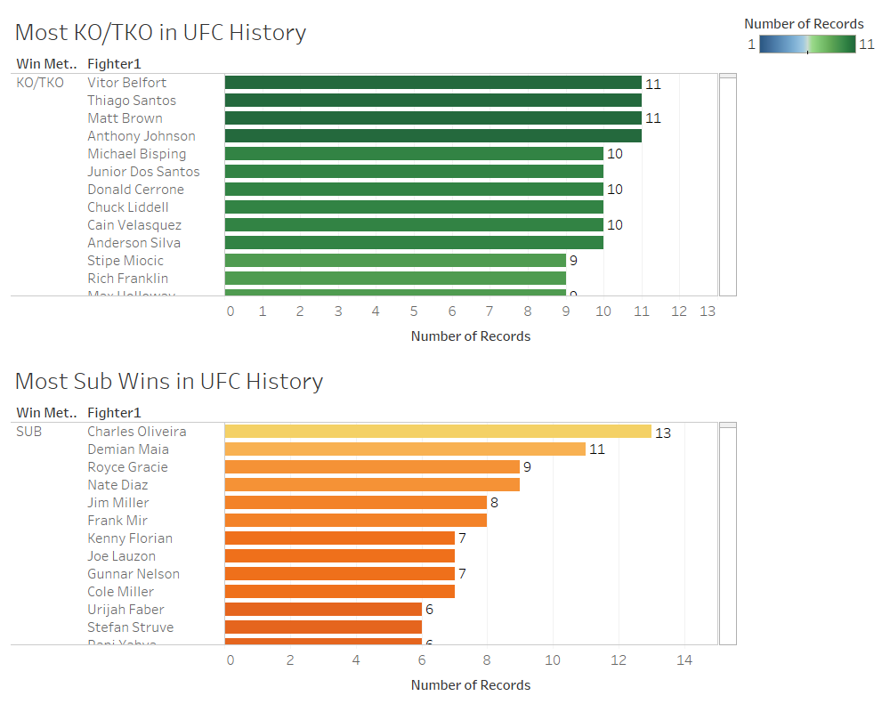

Slide 5
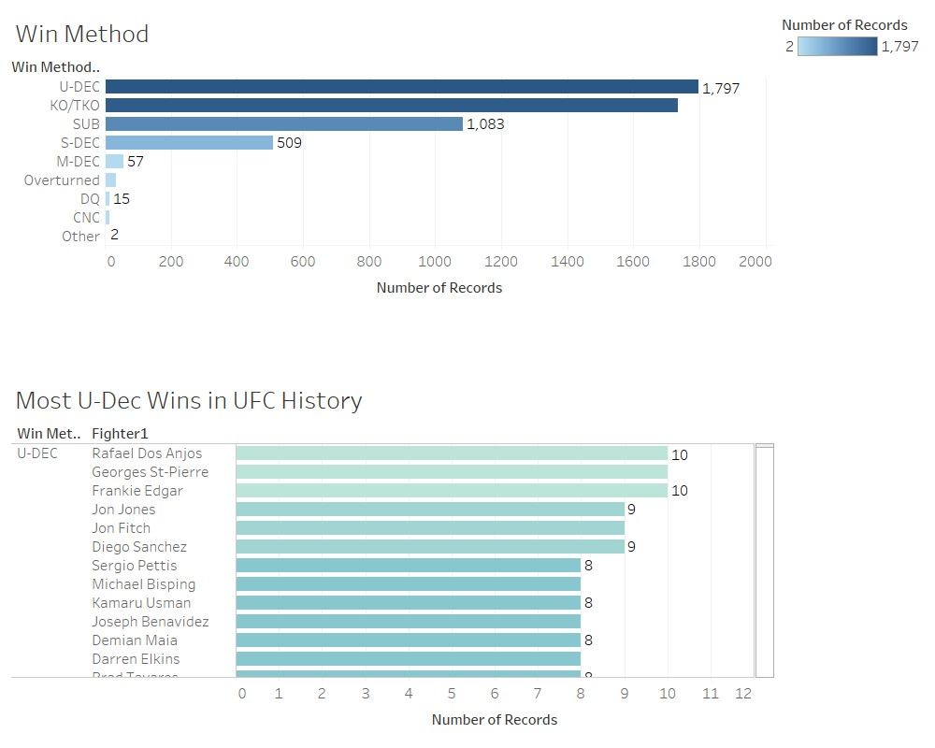

Slide 6
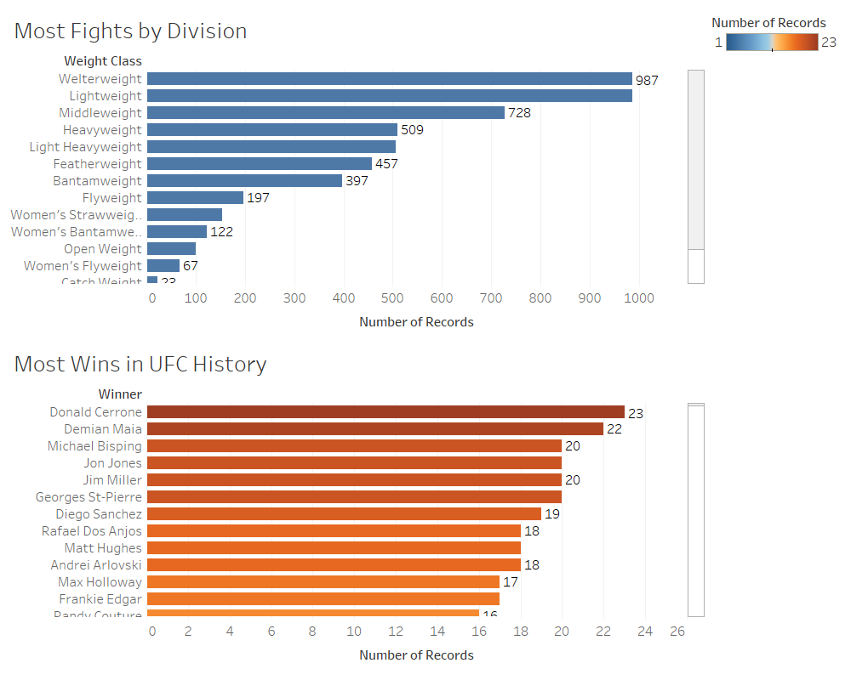

Slide 7
